Slide 1

Note Taking

Slide 2
Why Take Notes?
Taking notes forces you to listen carefully.
Notes provide a gauge of what’s important in the text.
Writing down important concepts helps you remember them later.
Notes are a good resource for test preparation.
Notes often contain information that cannot be found elsewhere.

Slide 3


Factors to Consider
Organization – notes should be easy to browse. Find an organizational style that works for you and be consistent.
Legibility – you should be able to read and understand your own notes.

Slide 4

What to write down?
Most professors give “cues” to let you know what might be important to write down, make sure and pay attention if your professor says or does any of the following:
Says “this will be on the test”
Writes something on the board
Repeats a point or says it slowly
Places vocal emphasis on a word or phrase

Slide 5

Tips for Better Notes
Don’t try and write down every word.
Begin each lecture on a new page.
Write on only one side of the page.
Write notes in your own words unless there is a specific name, fact, or formula.

Slide 6

Note Taking Methods
Outline method
Cornell method
Mind mapping

Slide 7
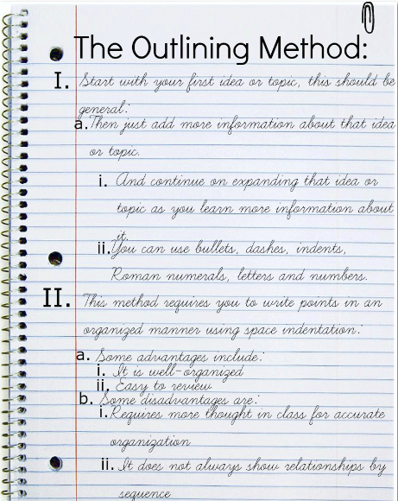
The Outline Method
The most common note taking method, the outline method involves using upper and lower case letters, numbers, and indentation to move from the general to the specific. Main points begin on the left and sub points branch out to the right.

Slide 8
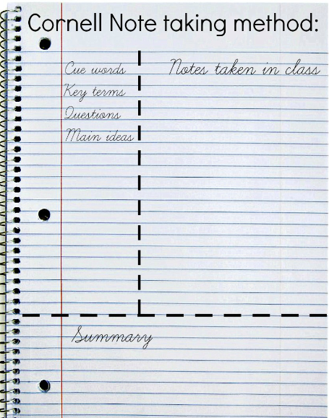
The Cornell Method
Divide your paper into three columns, two vertical and one horizontal. Write your main notes in the right hand vertical column, in the left write key words or cues. After class summarize what the notes are about in your own words in the bottom column.

Slide 9
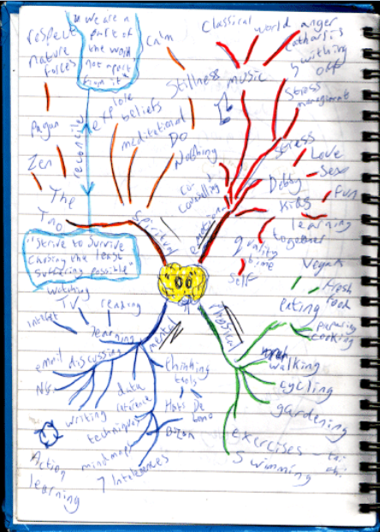
The Mind Mapping Method
Good for visual learners, mind mapping is where you draw your notes by beginning with a central topic or theme in the middle of the page and then branching off to show connections.
The Mind Mapping Method:

