Slide 1

Time Management

Slide 2

What is Time Management?
Time management is the act or process of planning and exercising conscious control over the amount of time spent on specific activities, especially to increase effectiveness, efficiency or productivity.

Slide 3
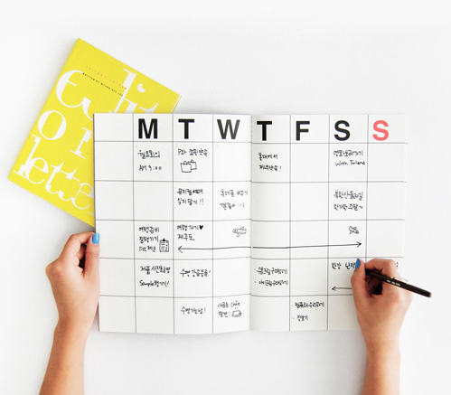
Get a Calendar
A calendar is an essential tool of time management. You can use a notebook style planner or an app on your phone or computer. Find one that works for you an write down everything in one place.

Slide 4
Prioritize and Set Goals
Decide what is most important and schedule time for it.
Set short and long term goals based on what you would like to accomplish.
Break large tasks into small manageable steps.

Slide 5

Schedule Everything
(and stick to it)
Work time
Class time
Friend and family time
Time for sports and recreation
Time to relax

Slide 6

Use Small Bits of Time Effectively
5,10, or 15 minutes can be used productively. Use small amounts of time such as before class, standing in line, or riding the bus to study your flash cards or review your notes.

Slide 7
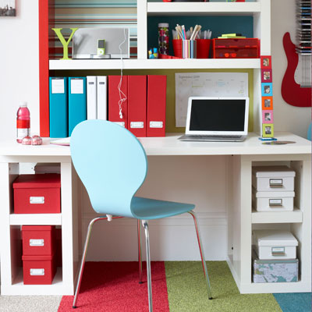
Create an Effective Work Environment
Choose somewhere quite to work
Organize your workspace
Remove distractions
Keep your workspace clean

Slide 8
Additional Time Management Resources
Dartmouth – Managing Your Time
Stanford – Time Management
Rasmussen – 6 Time Management Tips

